Slide 1
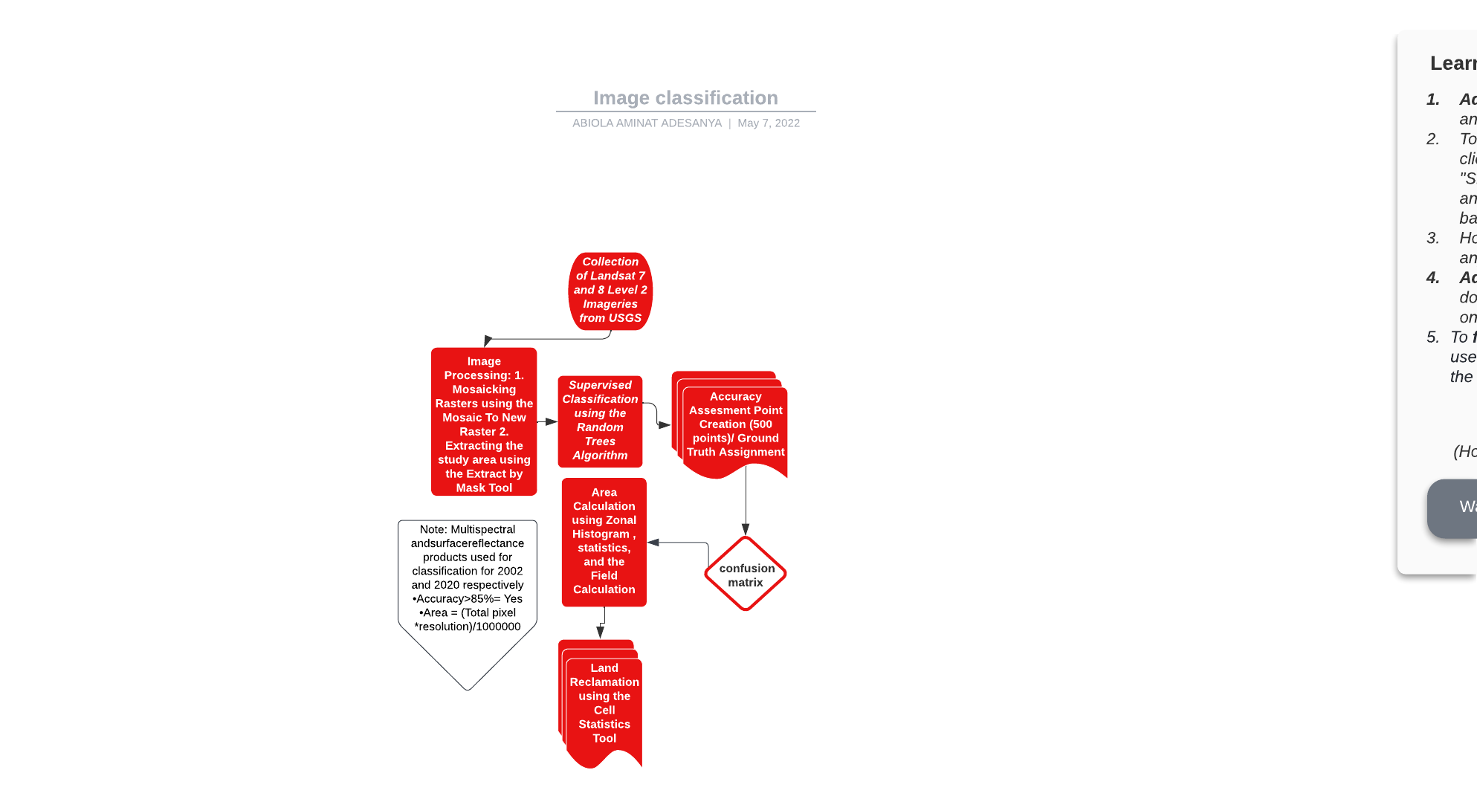
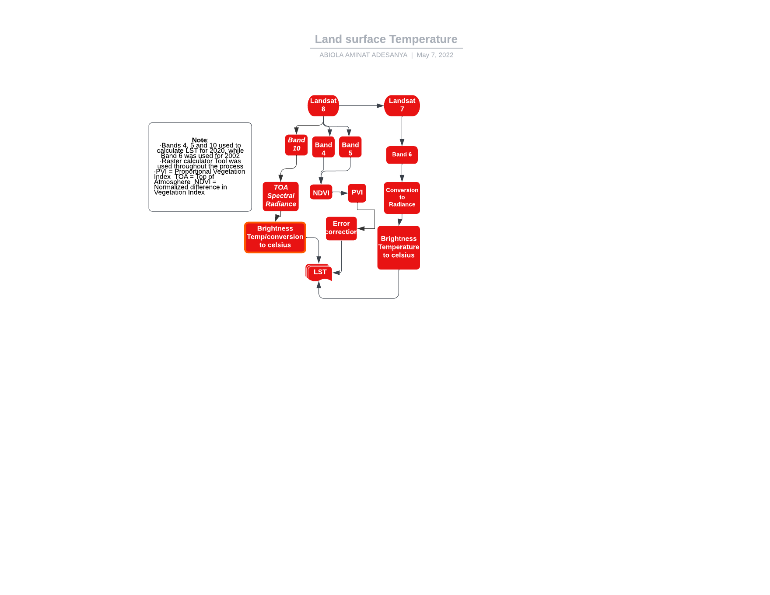
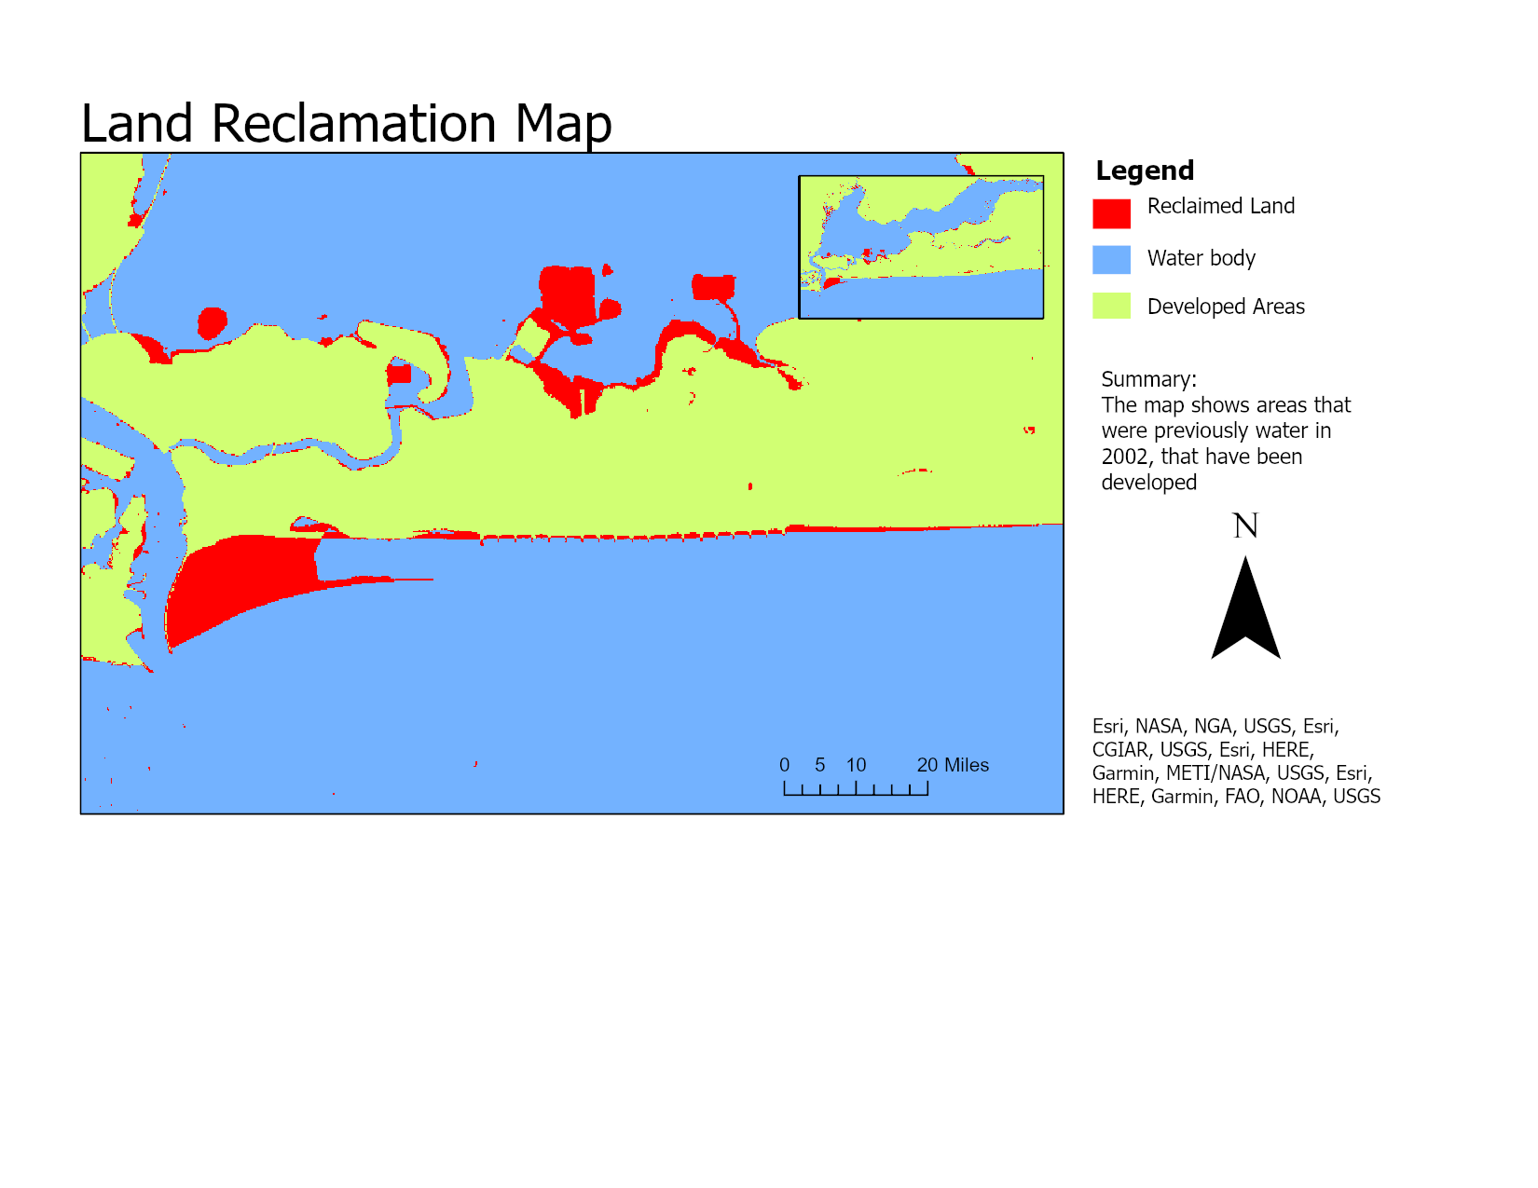
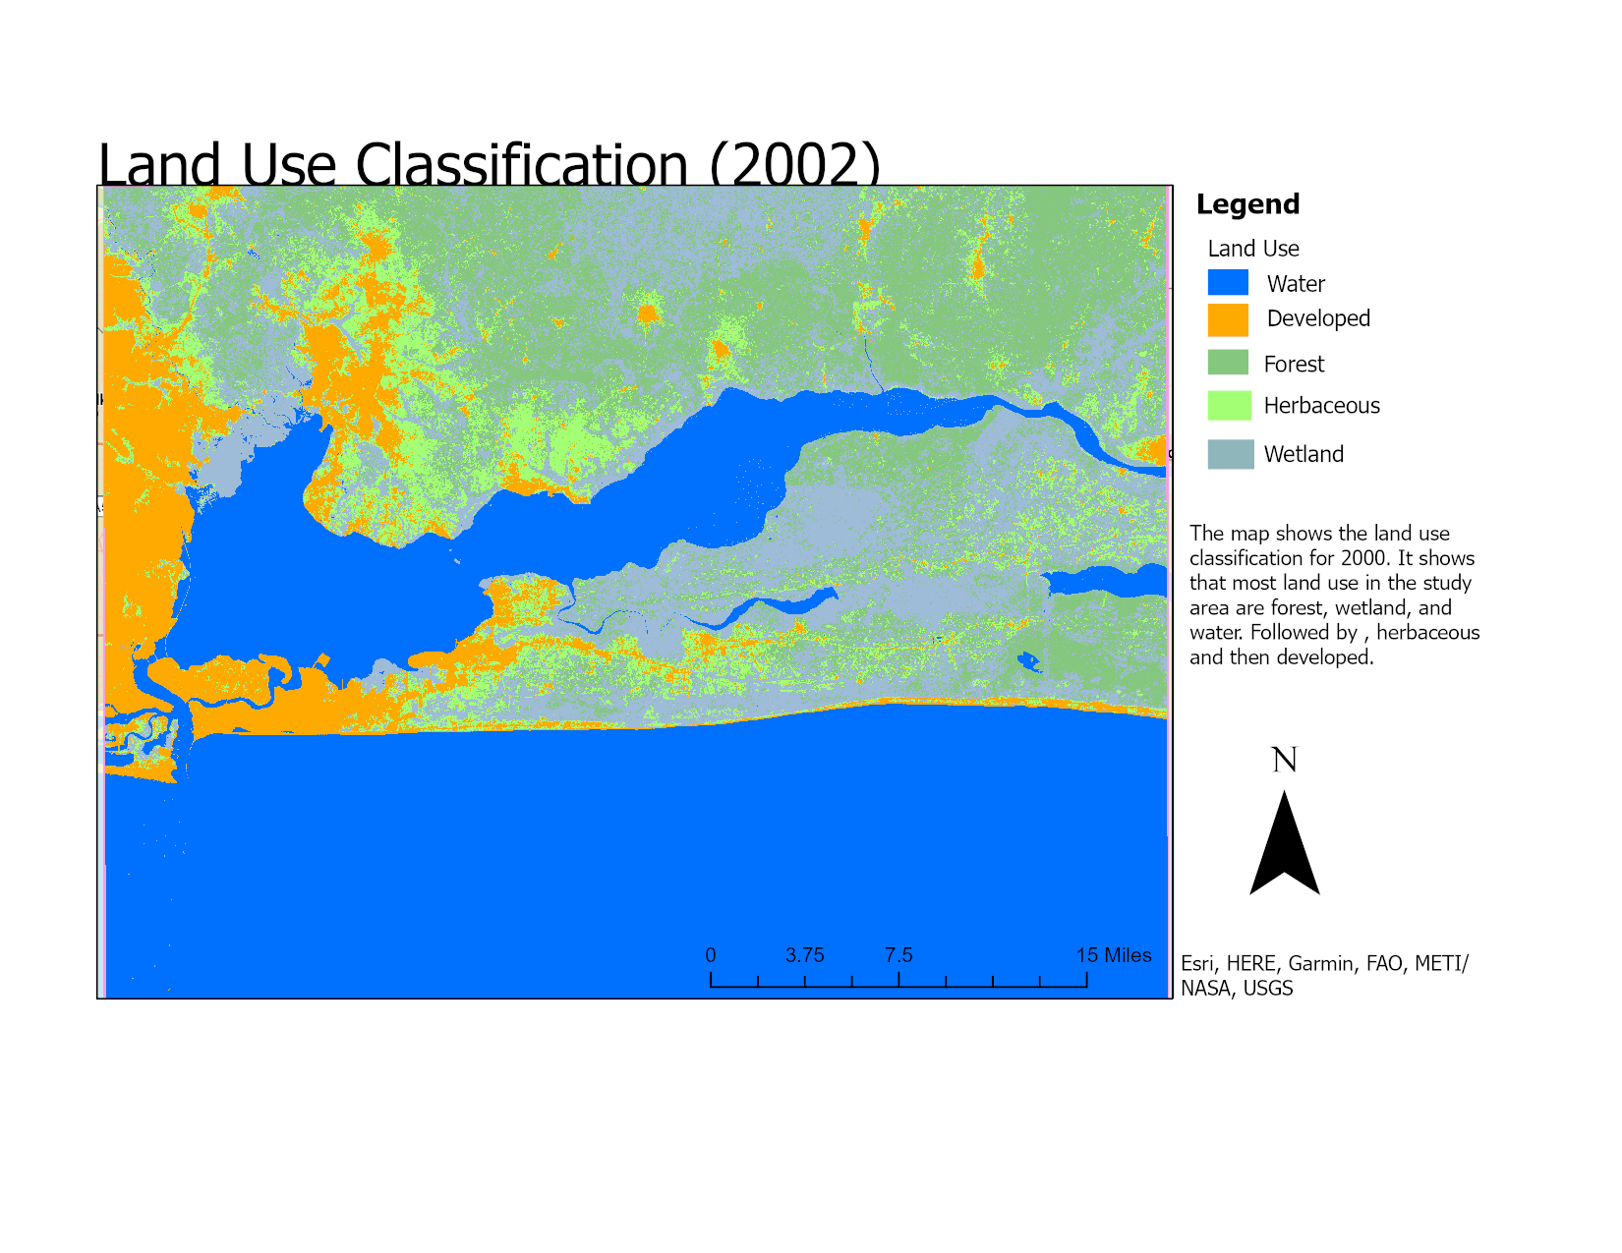
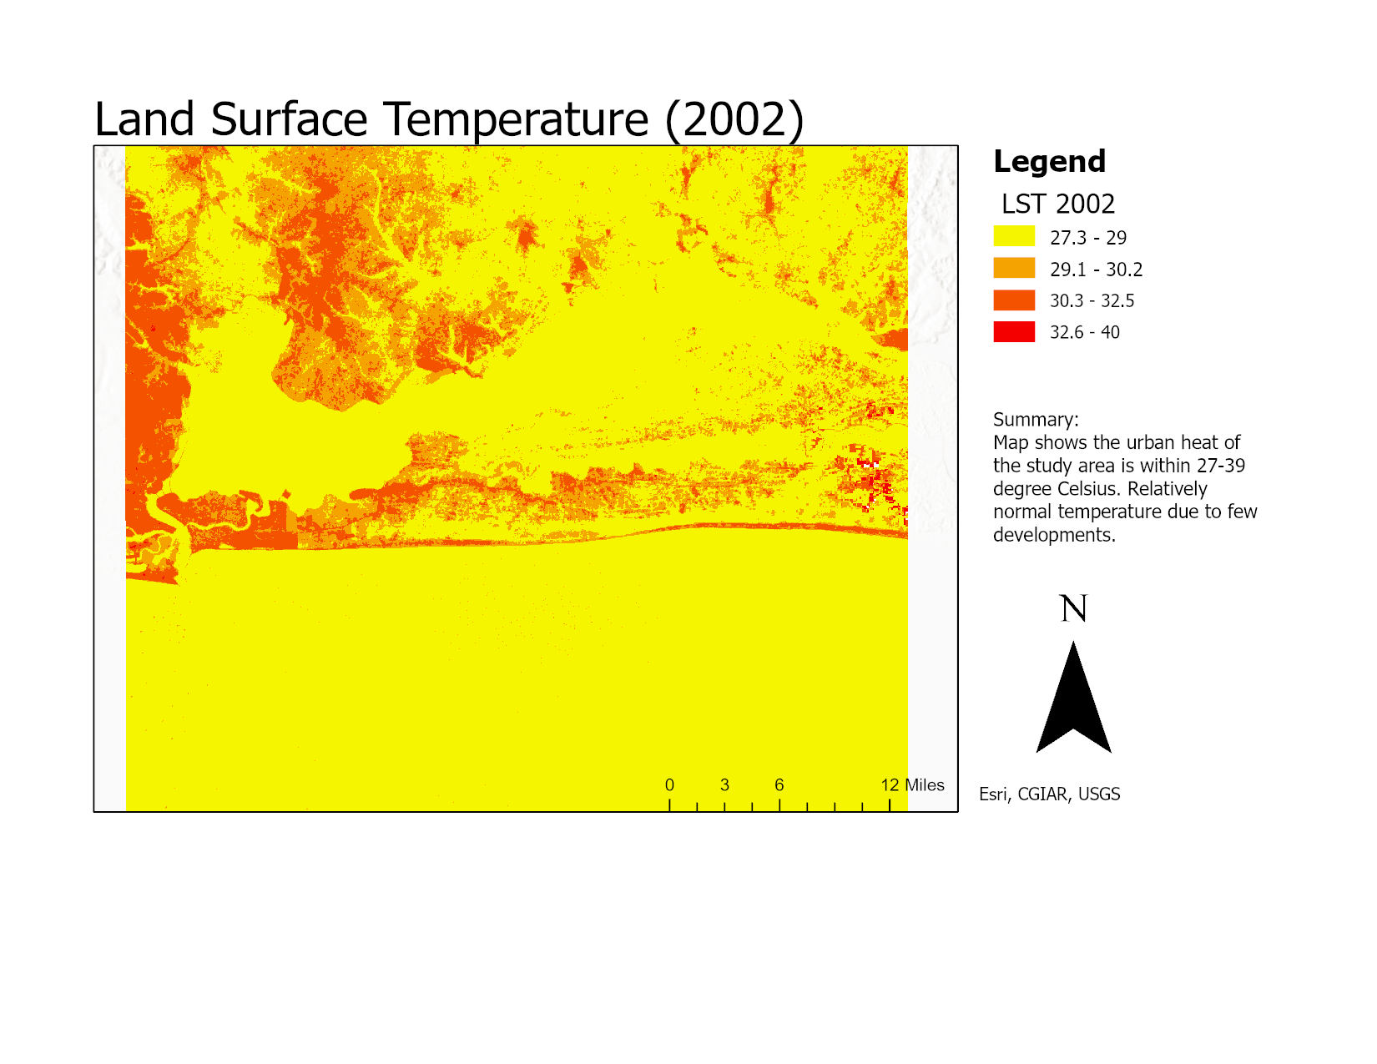
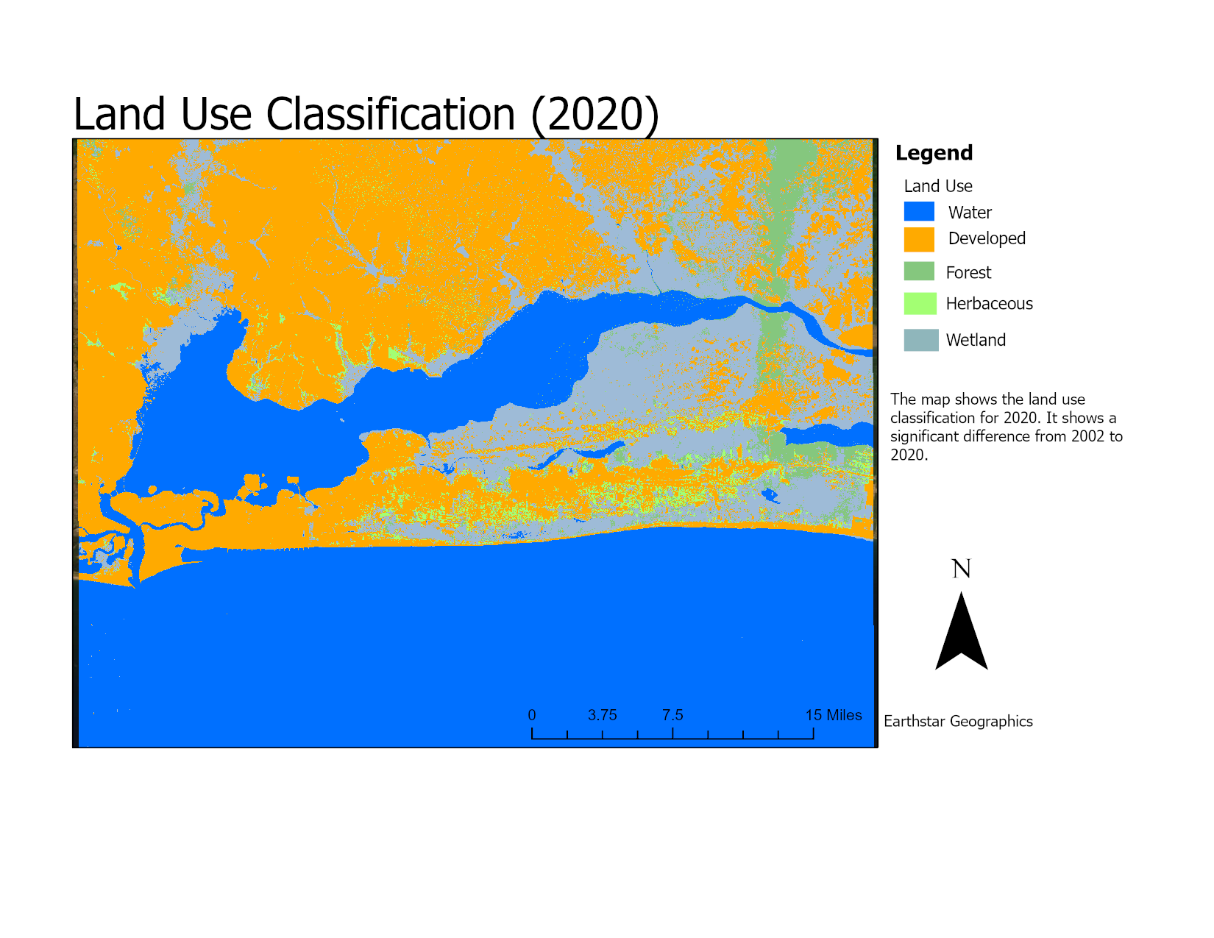
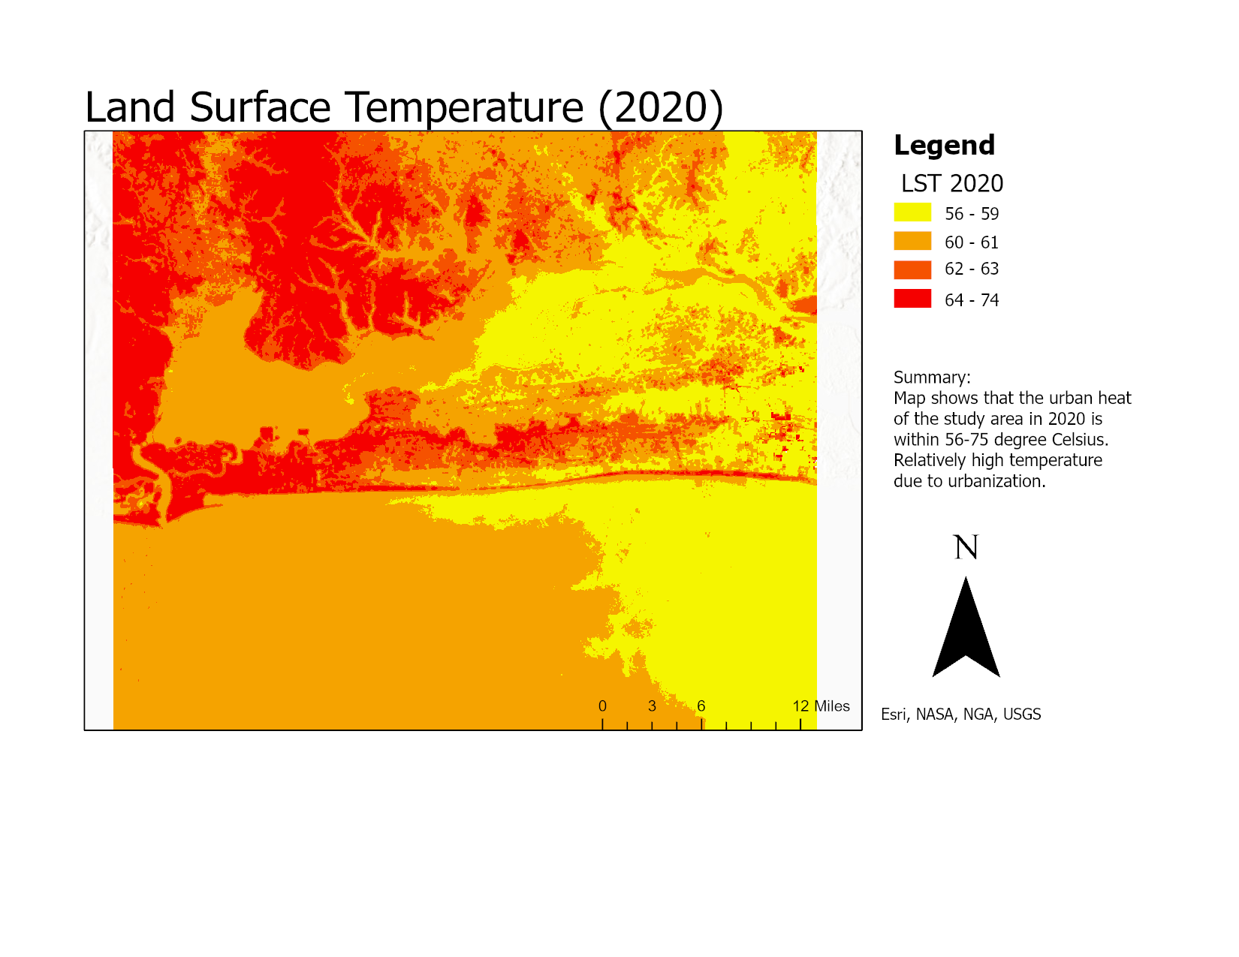
Department of Community and Regional Planning
CRP 554
May 11, 2022
Adesanya, Abiola Aminat
Geospatial Analysis of Urban Growth Dynamics and Land Surface Temperature in Lagos, Nigeria
Image Classification
LST
Results
Introduction
The accuracy assessment was above 85%. In 2002, the predominant land uses were forest, wetland, and water (see Table 1 below). There were also a few developments on the west side of the map. This same year, the average surface temperature was 33⁰ C. In 2020, the land use revealed the study area to be highly developed (see Table 1 below), The average surface temperature was 64⁰ C. This reveals a positive correlation between urbanization and land surface temperature. Changes across the classes are shown in the Table below. The land reclamation map reveals that about 34 km² of water was reclaimed between 2002 and 2020.
Rapid urbanization is currently one of the drivers of climate change. As human activities increases and the earth's surface is replaced with buildings, pavements, and tarmac roads, higher solar radiation is retained through greater thermal conductivity while the ability to release the heat at night stored during the day becomes low. The overall effect is a warmer urban environment. Rapid urbanization also results in Land reclamation practices in coastal cities to acquire land. Therefore, this study explores the effects of urbanization on land surface temperature (LST) in selected areas of Lagos State, Nigeria, and the extent of encroachment into water bodies. This study focuses on Lagos State, Nigeria, because it is one of the world's fastest-growing coastal cities and the country's commercial and economic capital.
Table 1: Summary of Findings
Aim and Objectives
This analysis provides information for policy response towards urban development, expansion, and management.
To identify and quantify land uses in the selected areas of Lagos in 2002 and 2020.
To calculate the LST of 2002 and 2020 in the study area.
To spatially understand the extent of encroachment into the water body between 2002 and 2020.
Conclusion
The study area is highly urbanizing, and reclamation is part of the process of increasing the amount of land available. There is evidence of changes in temperature which could lead to dramatic negative changes such as sea level rises, warmer ocean temperatures, increase in extreme weather events, and some diseases and pests. It is thus recommended that policies are put in place to control developments, and reclamation practices.
Techniques
Data set: Level 2 Landsat imageries
Tools and Techniques: ArcGIS PRO ModelBuilder:
Extraction Toolset
Raster Mosaic
Classification & Pattern Recognition Toolset
Random Trees Classification
Accuracy Assessment
Zonal toolset
Local Toolset
Normalized Difference Indices
Raster Math
References
Oppong, J. (2021, July 11). How to use arcgis
pro to map urban heat islands. GIS Lounge. Retrieved May 4, 2022, from https://www.gislounge.com/how-to-use- arcgis-pro-to-map-urban-heat- islands/?msclkid=c8dd76e4a98011ecbdf d7f982c9f074f
Survey, U. S. G. S.- U. S. G. (n.d.). Earthexplorer.
EarthExplorer. Retrieved May 4, 2022, from https://earthexplorer.usgs.gov/
The success of this project would not have been possible without God Almighty, and the overwhelming patience and support from Dr. Brian Gelder. Special thanks to Tim for all his assistance throughout the semester. I am grateful!

